Slide 1
Journey PPT – Week 5 (19/09/23 – 22/09/23)
Megha Sharma
Associate Data Engineer
Emp ID: 654810

Slide 2
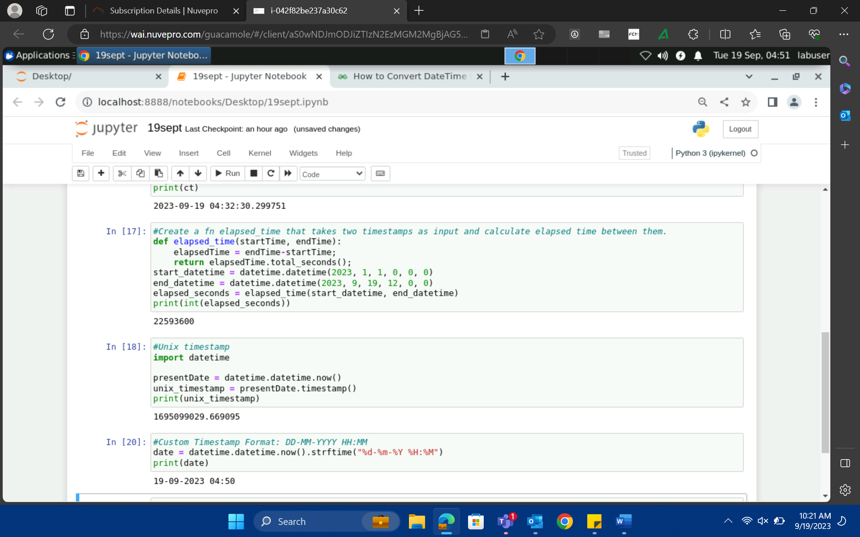
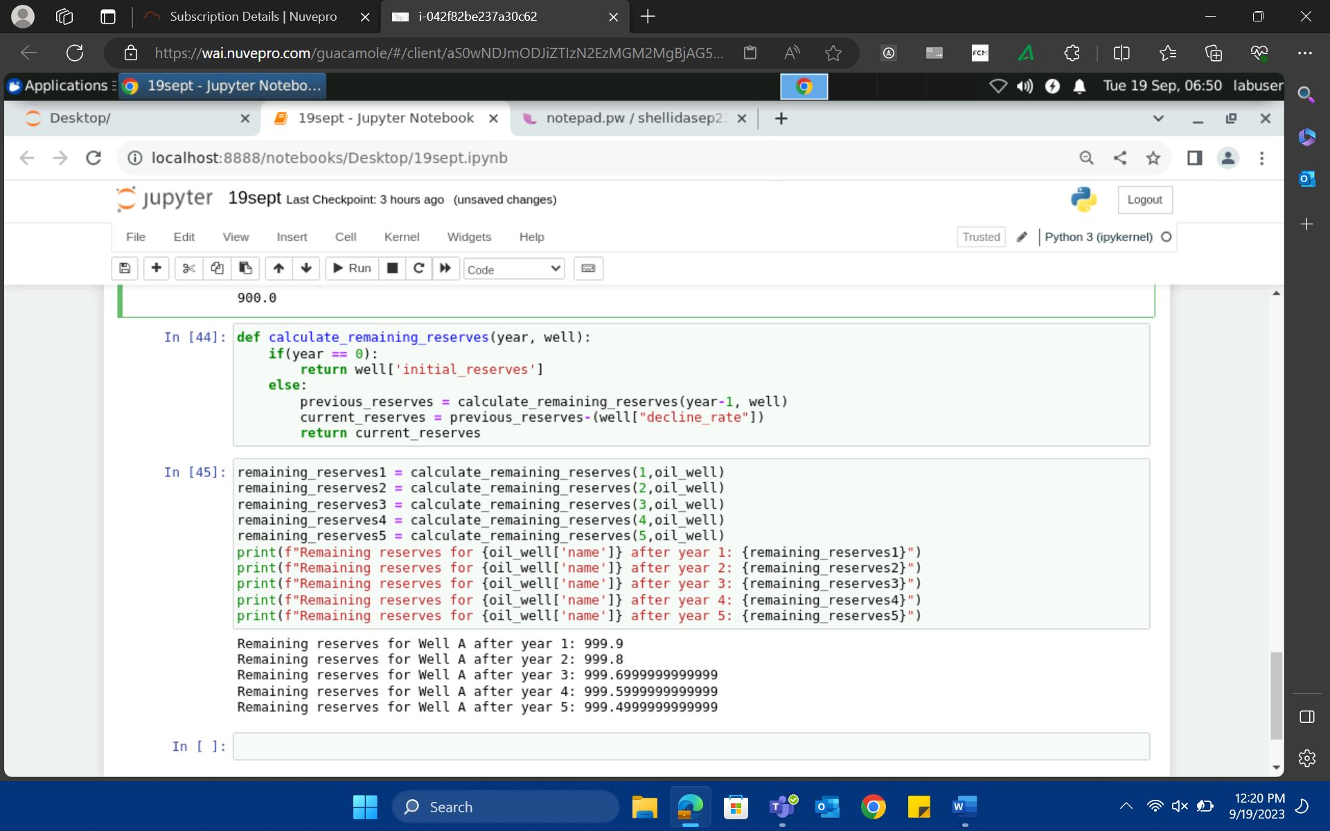
19-Sep-23 (Tuesday) – Python

Slide 3
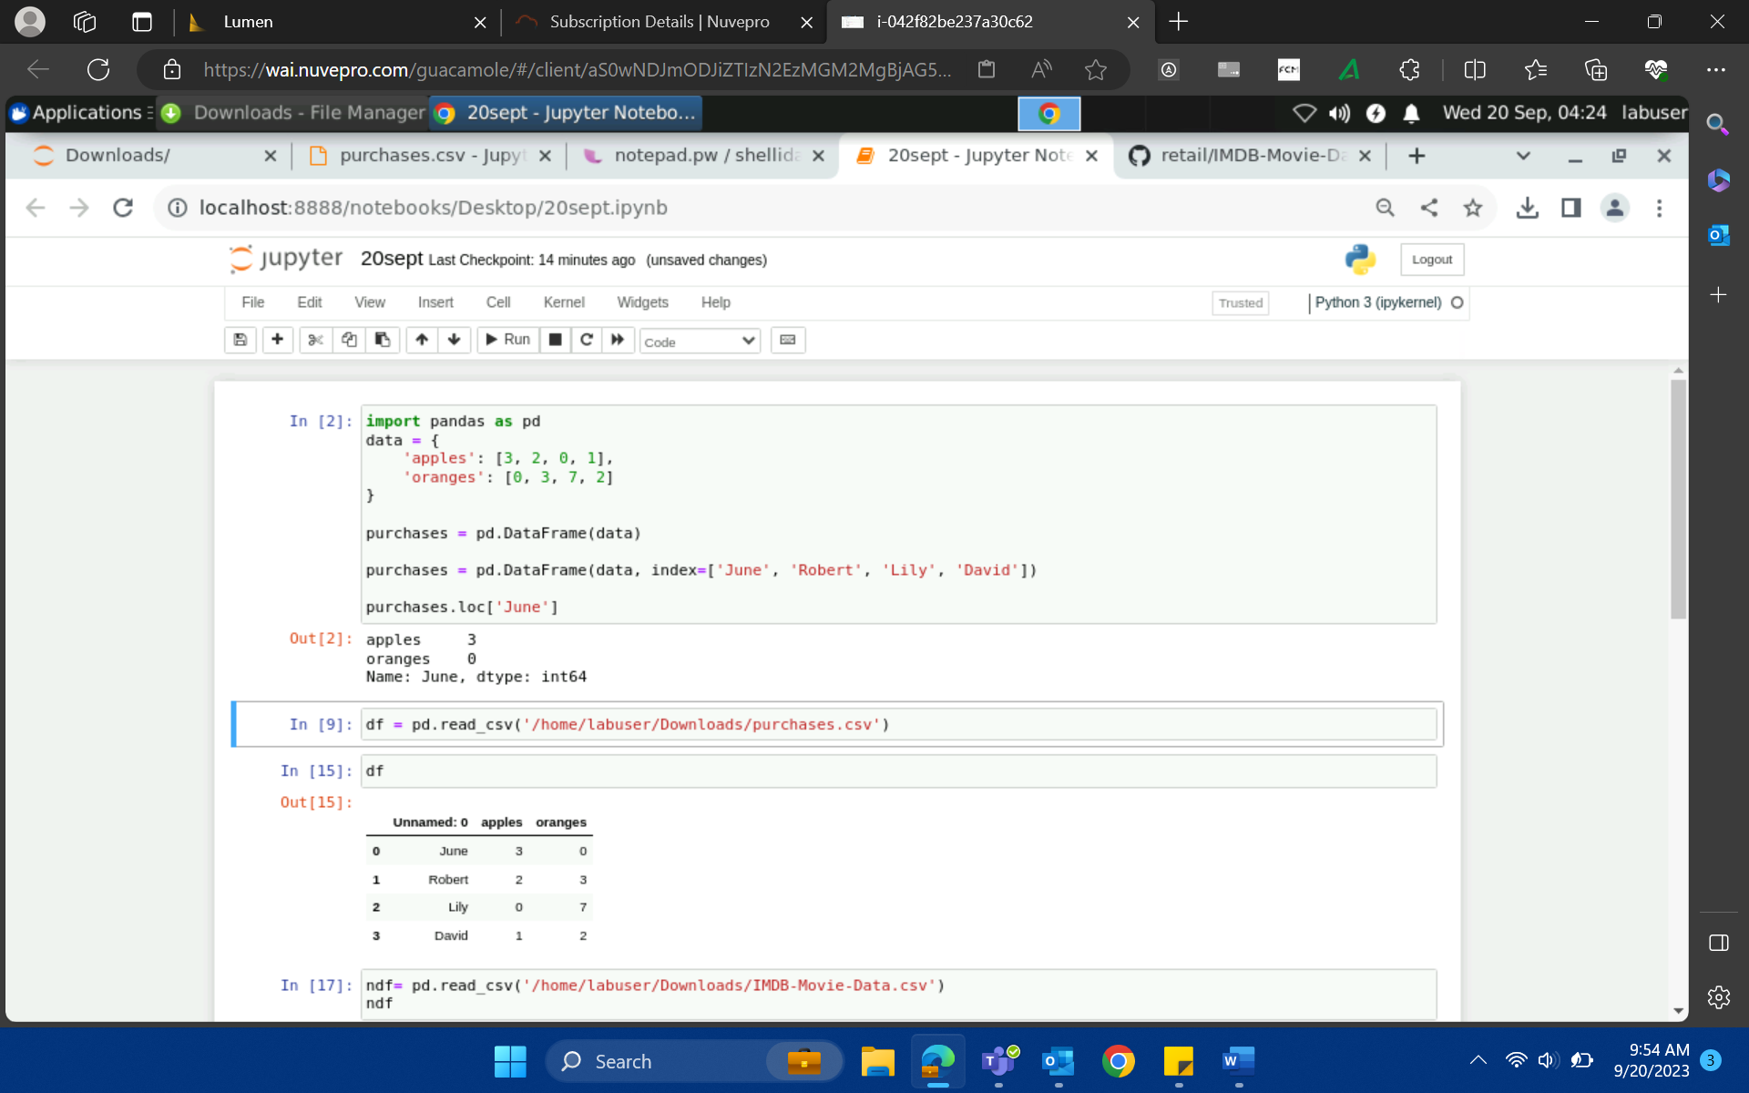
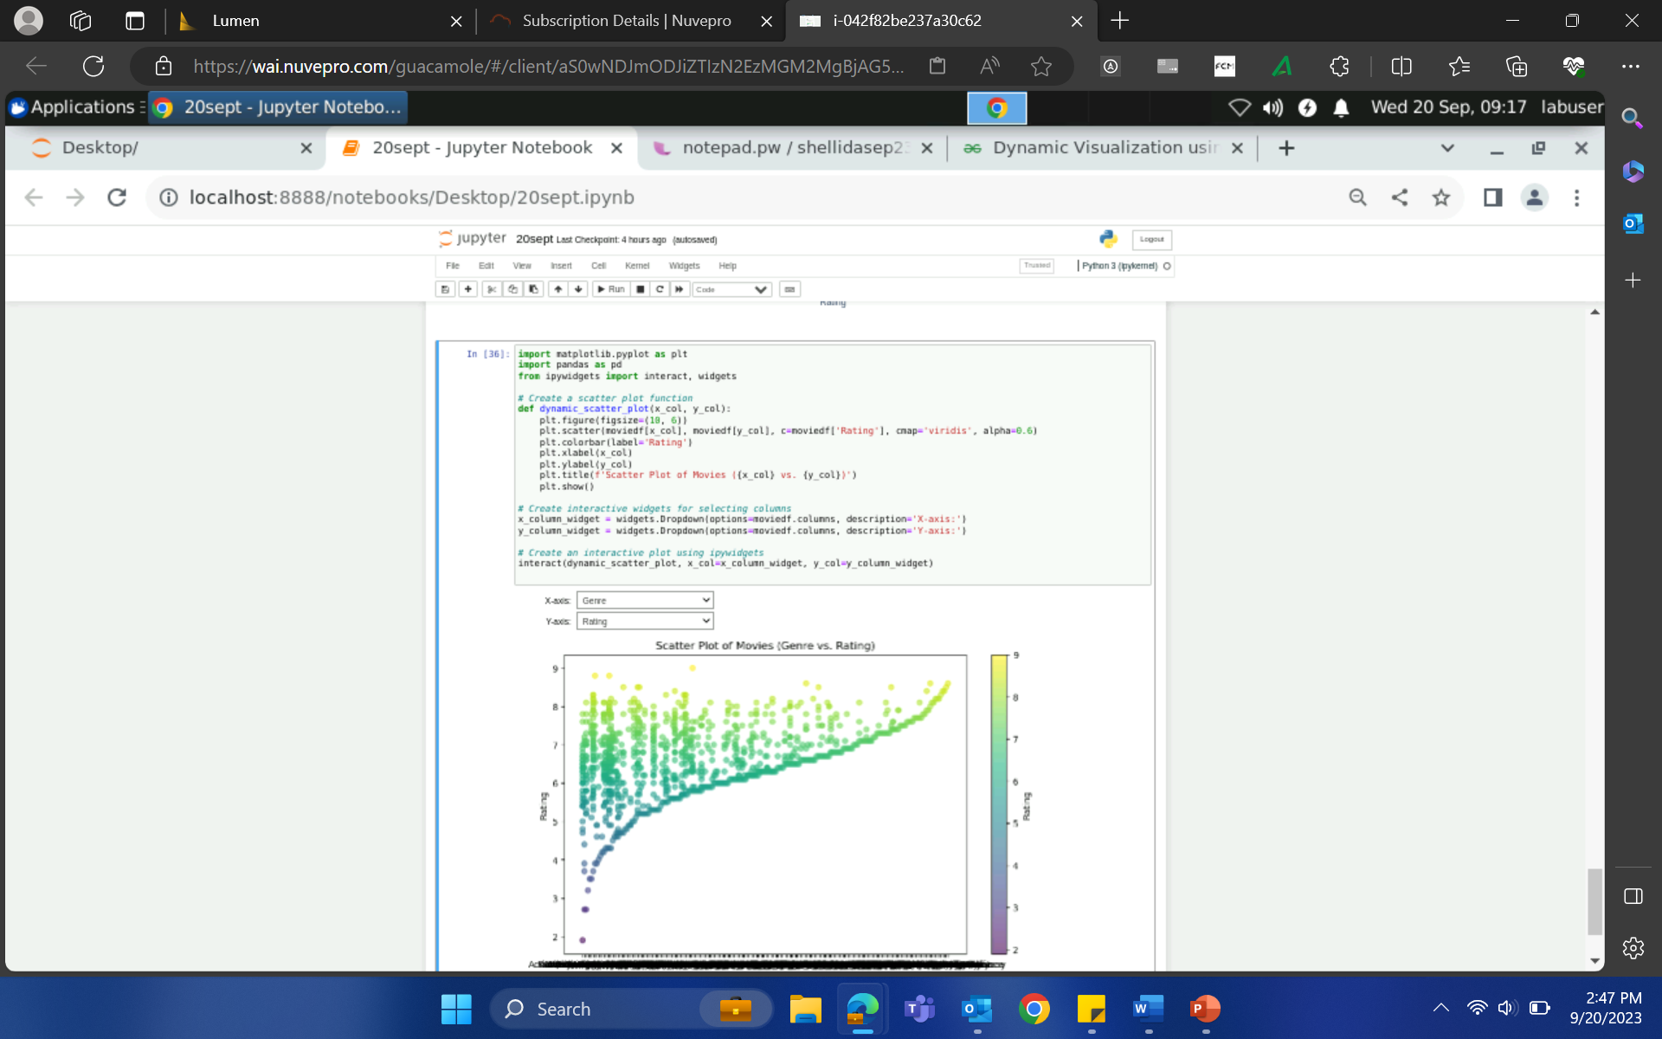
20-Sep-23 (Wednesday) – Python

Slide 4
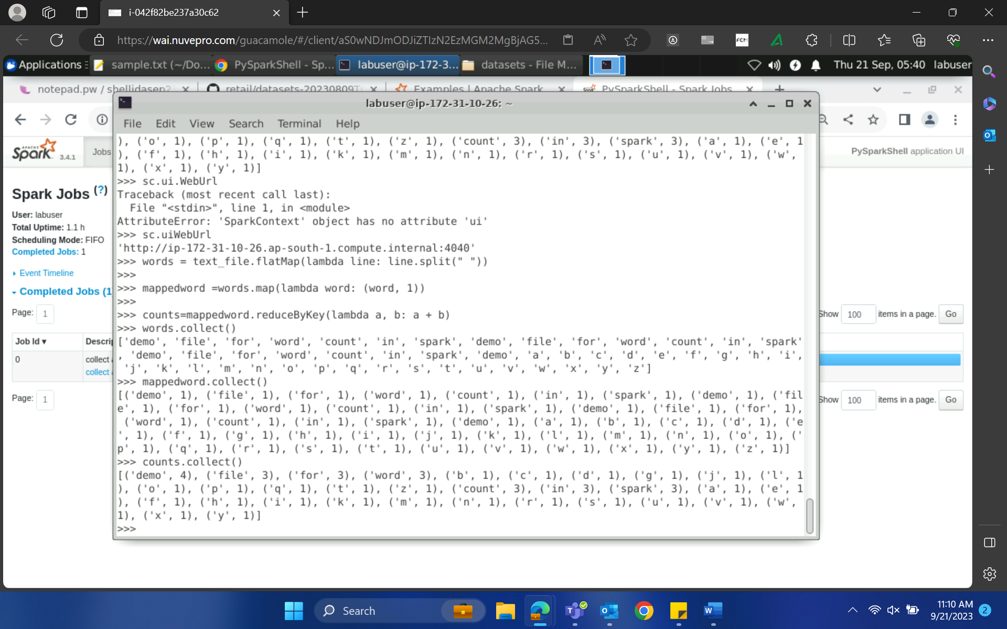
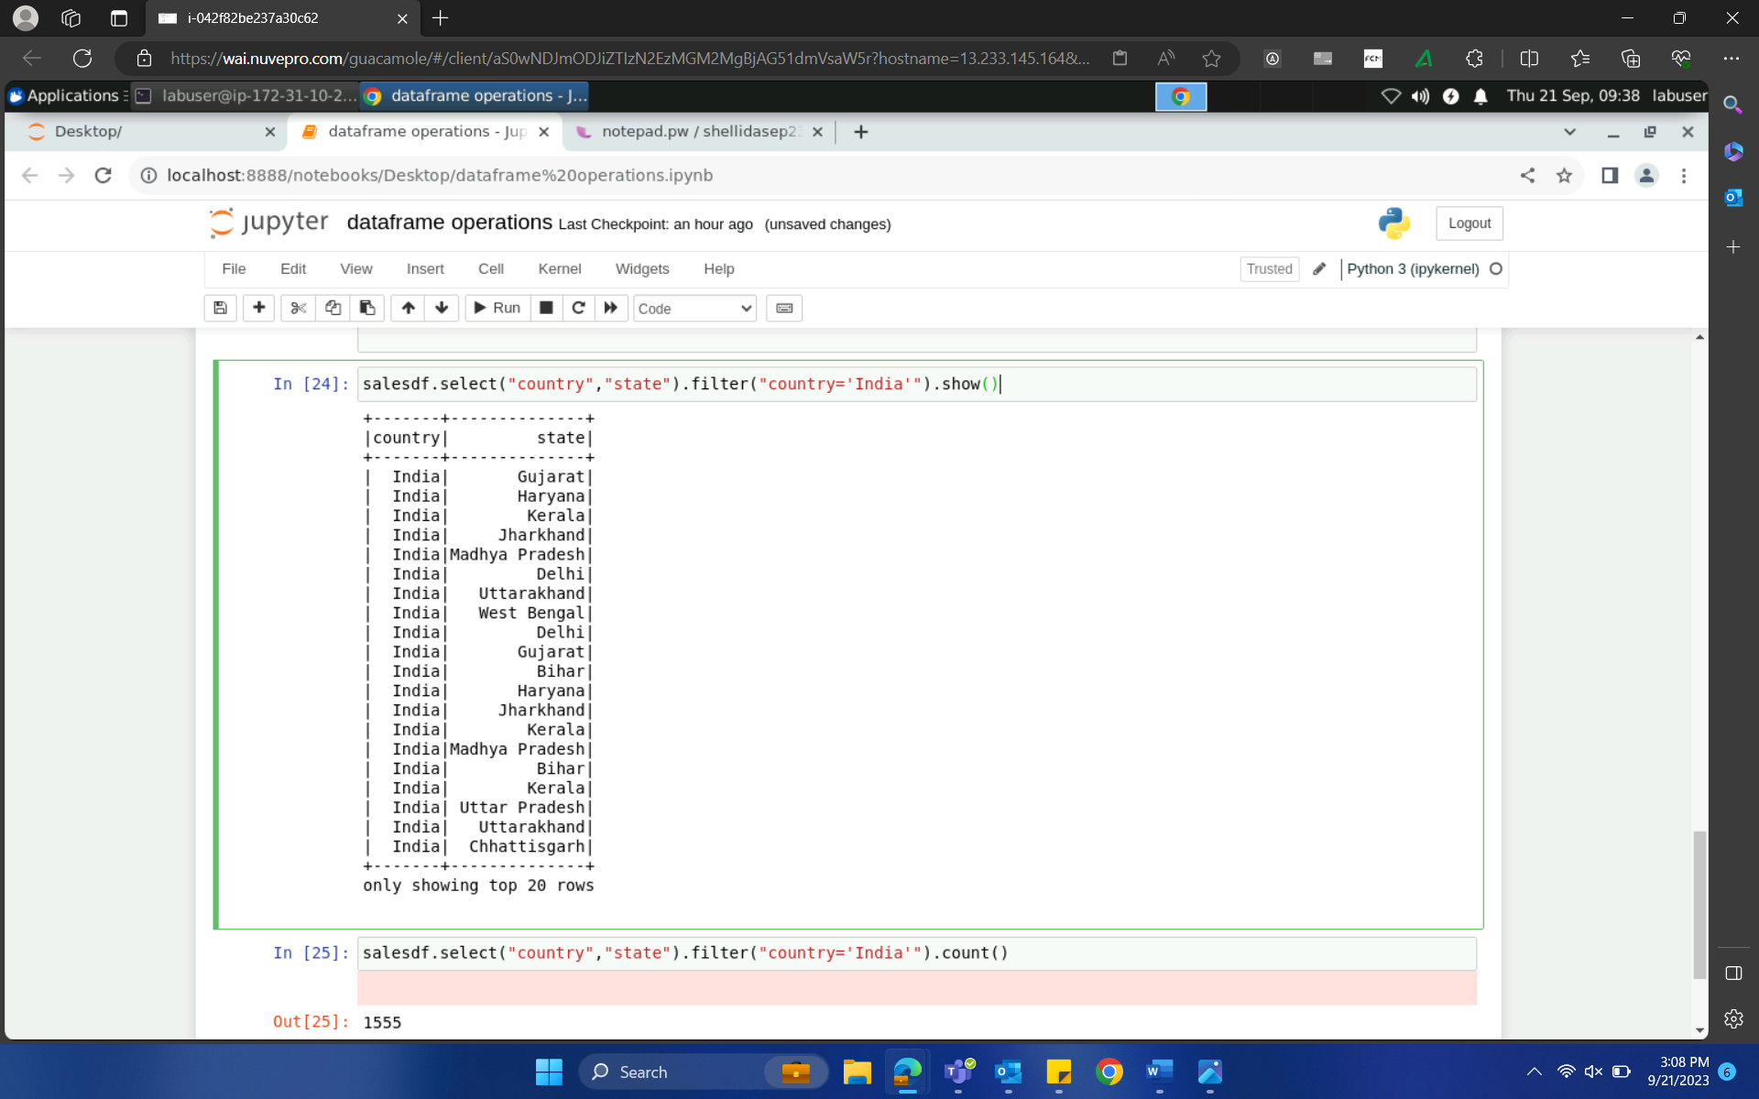
21-Sep-23 (Thursday) – PySpark

Slide 5
21-Sep-23 (Thursday) – PySpark
How to handle bad records:
Mode -> permissive -> replace the mismatched data with NULL
Dropmalformed -> drop all the corrupted records
Fallfast -> sensitive data -> throws exception
Duplicates: distinct() -> entire df and
DropDuplicates(“columns”)
Filter -> column and row
Column: select() || Row: filter/where
Spark components:
Job
Stages
Partition → worker’s memory
Each partition → one task → executed → one executor
Master → driver
Worker → executes the actual task
Spark context/spark session → entry point sc and spark

Slide 6
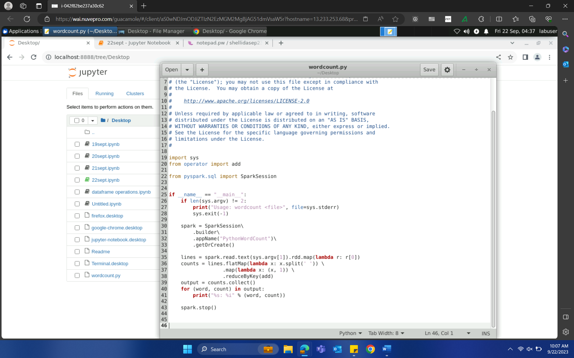
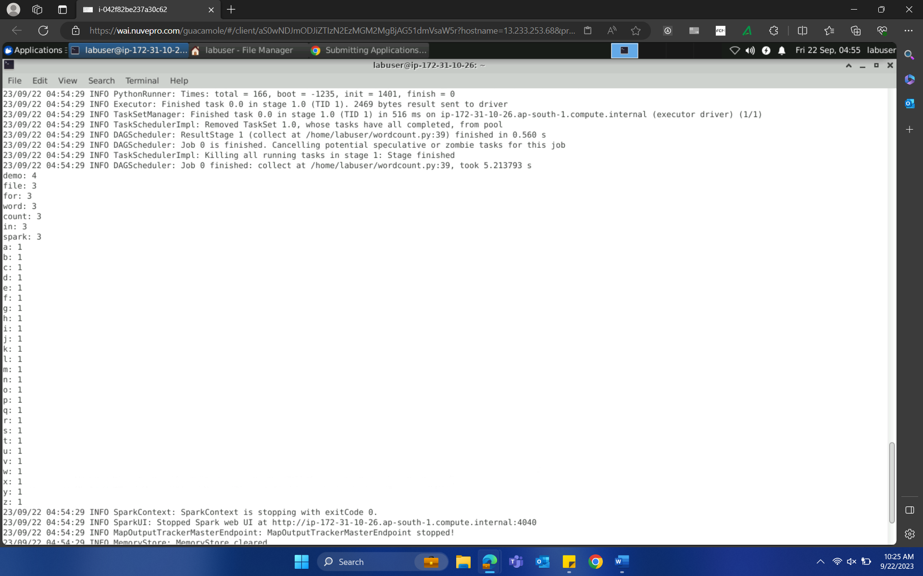
22-Sep-23 (Friday) – PySpark

Slide 7
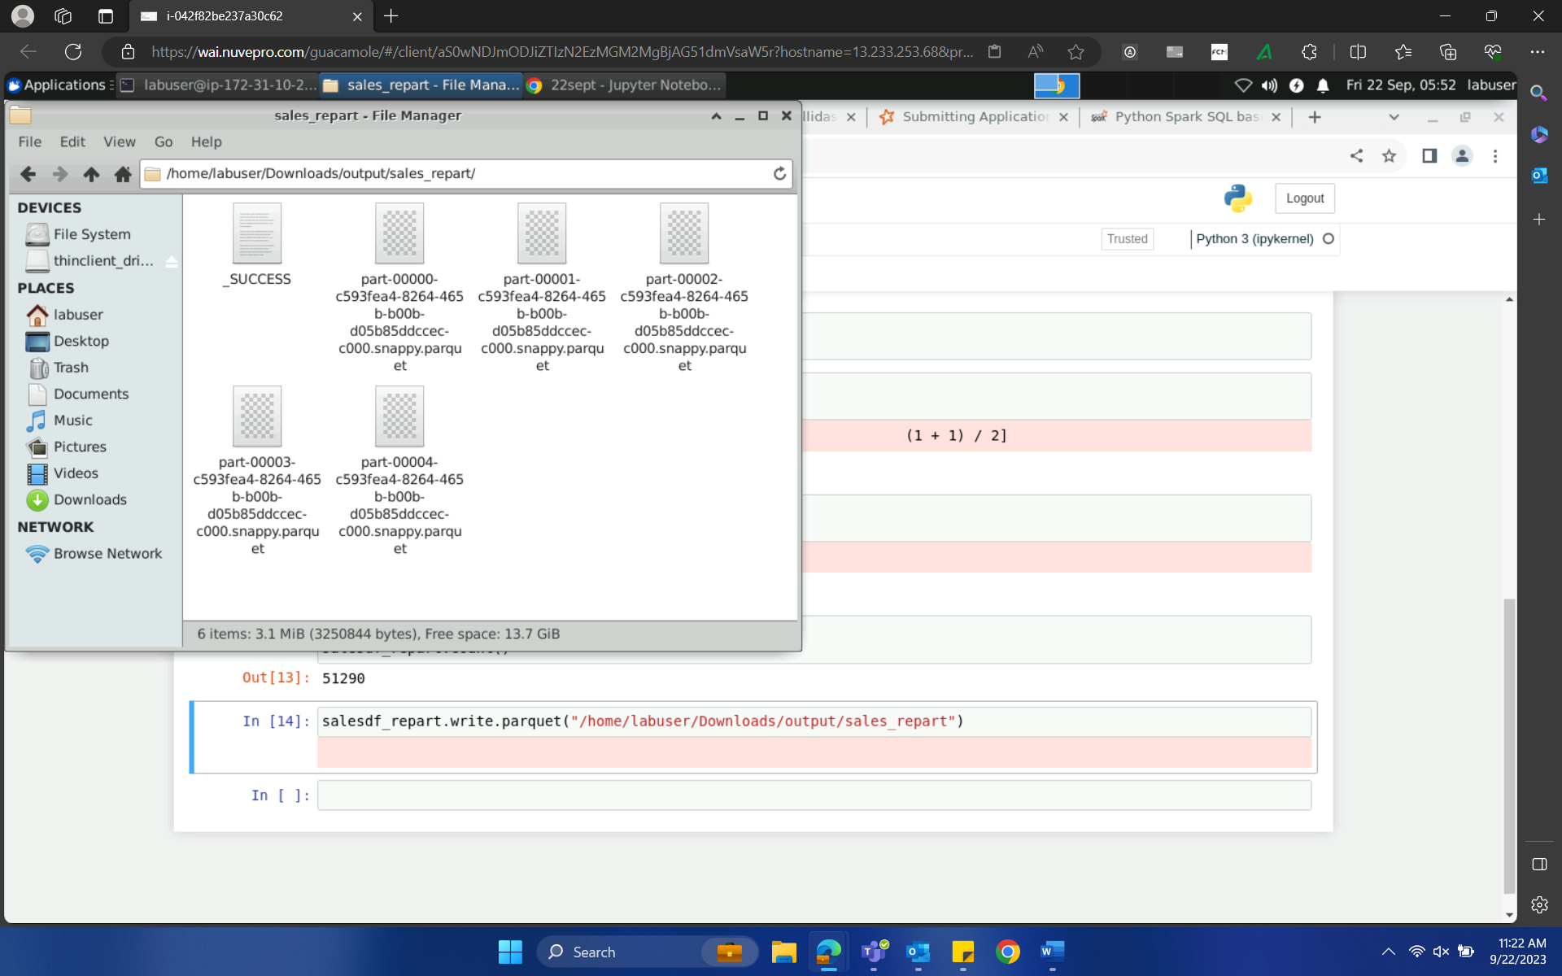
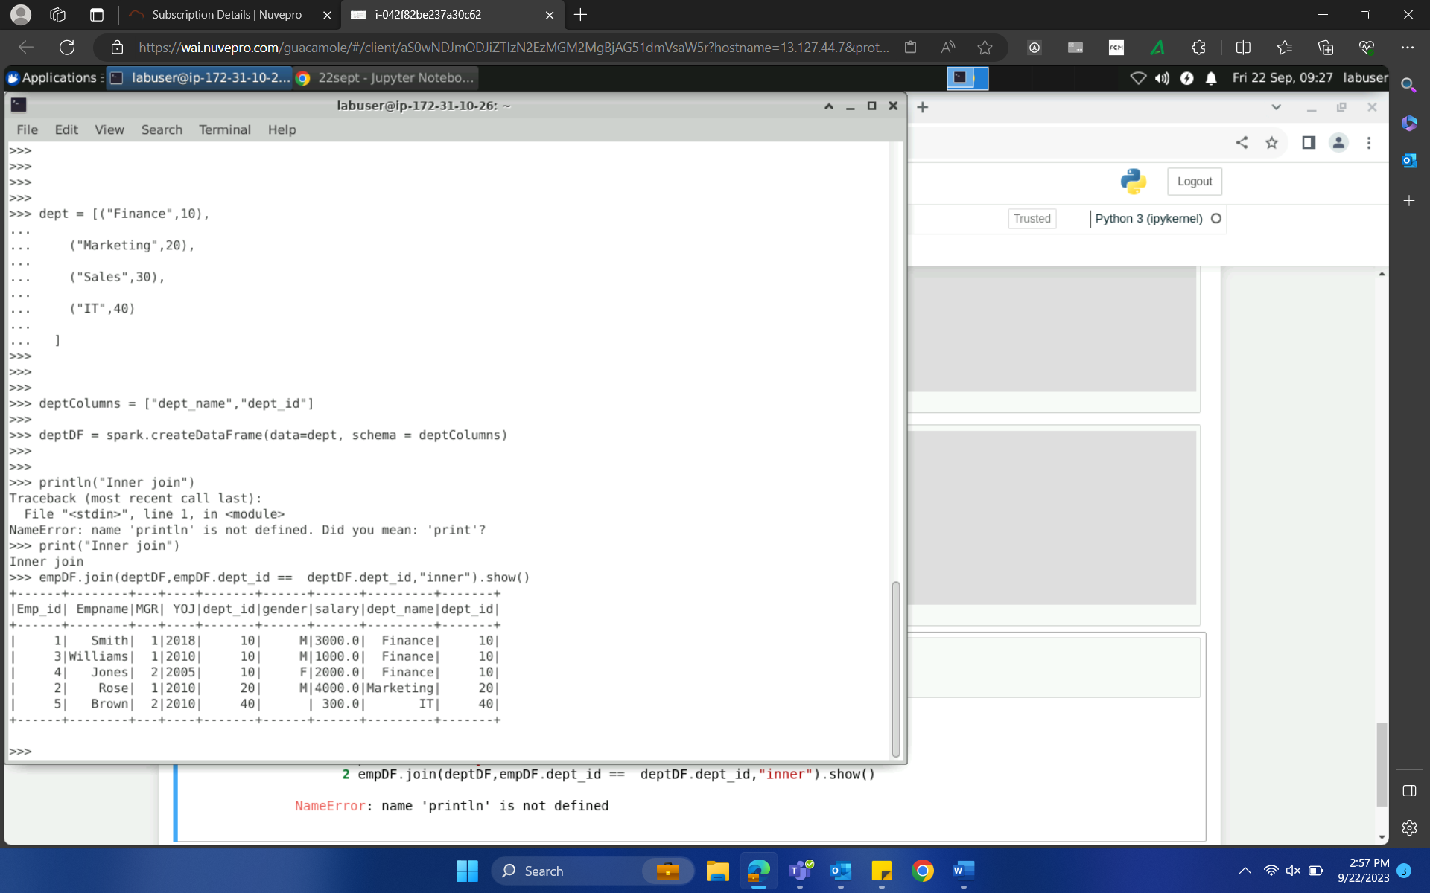
22-Sep-23 (Friday) – PySpark
Handling parallelism in spark
Repartition -> increasing/decreasing the partition
Coalesce -> decrease the partition

Slide 8
THANK YOU

